Slide 1

Rules and workings of the PSYC 399 – Summer Training of Department of Psychology in fulfillment of graduate requirements of students of and rules for voluntary internship
2025-2026
Training Coordination Office by Emine T. Ulaşan Özgüle

Slide 2
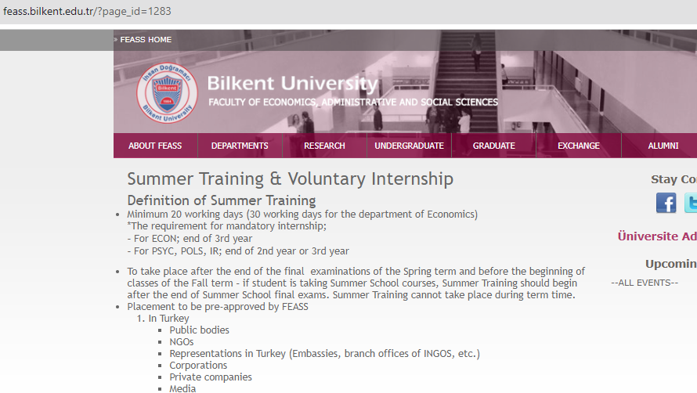
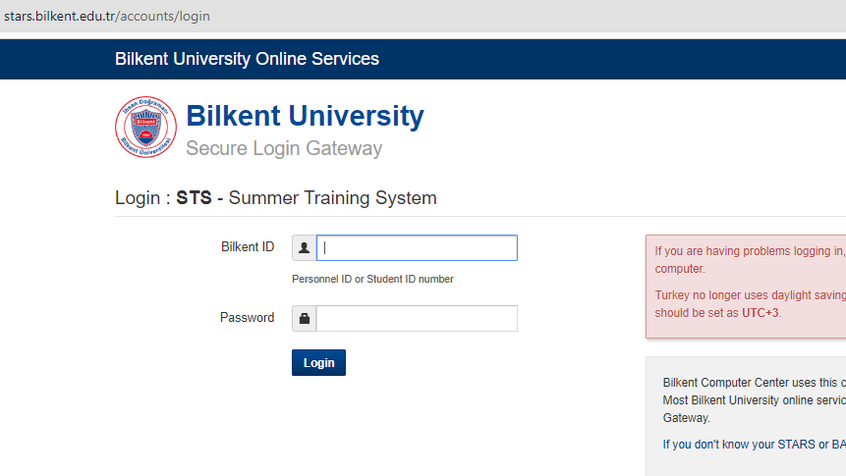
Psyc 399
General rulings of FEASS on summer training
  See & bookmark the FEASS - Summer Training & Voluntary Internship web page for future reference
  Your attention will significantly reduce the bureaucratic burden.
Practically all procedures regarding PSYC 399 are carried out on stars.bilkent.edu.tr/sts (STS) since 28 May 2024.

Slide 3
Psyc 399-summer training program guıdelınes for students
Following rules are binding for all parties and training related tasks
  Students
    Responsible to follow the rules
    Should abide by the deadlines to get necessary permissions
    Should update the necessary documents on time
Mandatory training
  Mandatory for all students to graduate
  Can only be done after the 4th semester after taking the bulk of mandatory courses
Voluntary training
  Optional for students to try different areas of work related with psychology
  Can only be done after the 4th semester after taking the bulk of mandatory courses

Slide 4
Psyc 399-summer training- mandatory traınıng
To register to 399, students should apply formally to STS BEFORE the training and get approval
  Cannot register for your previous voluntary training or part-time working for Mandatory
Applied to all conditions without exception
Can be done face-to-face, hybrid, or online working schedules
Bilkent will pay for your government social security during your training period;
  Not applicable for students who do training out of the country

Slide 5
Psyc 399-summer training- mandatory traınıng
DURATION– minimum of 20 days in total (can be longer)
  Should indicate whether it covers Saturdays of not
  Should count for the holidays and exclude them
  Cannot have training when the school starts or before you finish summer courses if you have any
  Has to be a fulltime job
Cannot be an education program where you pay tuition
  Any orientation, supplementary case studies, or provided training presentations are acceptable

Slide 6
Psyc 399-summer training- mandatory training and Erasmus
If you applied to Erasmus+ and accepted, can be considered as mandatory training
  Can also apply if you are funding yourself abroad after being accepted by the organization
Application to Erasmus programs is not coordinated by the training coordination office
  However, applications for mandatory training through Erasmus+ (a training program funded by Erasmus) is done by the Training Coordination Office after you get accepted to Erasmus+
If you have more than 20-30 working days off between the end of the previous semester and starting of your Erasmus Program (education-not Erasmus+)
  Can do mandatory training during that time
  Register the following semester

Slide 7
Psyc 399-summer training- mandatory traınıng
Students are responsible to find suitable organizations to complete their training
  Due to ethical reasons, cannot match students with organizations
  Hence, not to create pressure on students into certain organizations or areas
You may see the previously accepted organizations in STS
Can do training as an intern in a private or public organization or by participating in research in a research facility (including Bilkent University if a faculty member endorses).
  Field preferred up to now; education, clinical psychology, testing and measurement, statistical analysis, marketing and advertisement, any related field that focus on sales and focus groups, human resource departments, psychiatric and/or addiction facilities, private and public hospitals, preparing training content for employees and giving training on interpersonal skills, Preparing content for social media, neuroscientific and/or psychological research groups, etc.
Getting education in an organization is not accepted where you pat tuition

Slide 8
Psyc 399-summer training- mandatory traınıng
STUDENT TRAINING APPLICATION FORM
Get this form from FEASS- Summer Training web page
Is the evidence of your application & initial job description.
Has to be completed before your online application through stars.bilkent.edu.tr/sts
There should be a formal stamp on the document and signed by the person who will oversee the completion of the training
You’ll upload this document during your application
STS will notify you in case you are not eligible for PSYC 399
When not possible to submit, may present the screenshot of the acceptance by the company if these is a formal email address
http://feass.bilkent.edu.tr/?page_id=1283
PLACEMENT INSTITUTION ACCEPTANCE AND INTERNSHIP AGGREEMENT FORM
Get this form from FEASS- Summer Training web page
Is a document required by the organization
Only necessary if the organization asks for it (wants to make a contract with the student and University that the student will follow the rules of internship) – Bilkent University does not require or use this form for training application
This form will be completed and signed by the training coordinator and the person responsible overseeing student’s training at the organization-if organization accepts, online signatures are accepted
You may apply with this document or with Student Application form for training through STS – no need for the hard copy

Slide 9
Psyc 399-summer training- mandatory traınıng
STUDENT SUMMER TRAINING REPORT FORM
Get this form from FEASS- Summer Training web page
Is the document that shows what you have done through training
Have to answer nine questions and provide an overall evaluation of your training process as a summary of your experience
Better to keep training diary in order to submit a better and more detailed report
See following slides to see the structure of the form and potentially well written report
PLACEMENT INSTITUTION SUMMER TRAINING EVALUATION FORM
Get this form from FEASS- Summer Training web page
Is a document, in which the institution evaluates your performance through training
Organization should submit this form through an email to FEASS mail address (feassintern@bilkent.edu.tr) – no need for a hard copy
Please make our University proud with your performance

Slide 10
Psyc 399-summer training- mandatory training report
Advice: Read the questions before the training
  To keep a diary of training make it easier
Structure of report; How to report your accomplishments (The first question)
  Always start with a general overview of company; the field it is in, its size, the department you get the training in, how the department is functional to the company, etc.
  Summarize the tasks you had done
  Explain tasks one by one
Go on and answer the other questions
Please think about questions so that you have increased awareness of the training experience and use it as a steppingstone for your future.

Slide 11
Psyc 399-summer training- mandatory training report EVALUATION
Precondition for evaluation
  At least an average of 3 or more from the questions using the Likert scale
  If not (average of 2 or less), you will automatically fail.
Evaluation of the report
  The condition is to answer all the questions after a deliberate consideration
  If any criteria reported missed, you may get an “incomplete” at the end of the semester
  Write a new report and submit within the required time to reverse “I” to “Satisfactory”

Slide 12
Psyc 399-summer training- mandatory training Deadlines
Registration start; after the semester is over
  23rd of May
End of applications
  31st of July, 17:30
Applications are required to be done 7 days before the summer training begins – required by Human Resource Department
Applications through TUSAŞ (Turkish National Internship Program)
  The dates are already announced
  Opens up every year;
    Coordinated by İŞKUR (Agency of Employment) rather than the President’s Office
  May take a whole year to earn
  Usually inform later rather than sooner; may create problems

Slide 13
Psyc 399-summer training- mandatory training for graduation
If you failed to complete your mandatory training but about to graduate
You may take 2 courses during summer
  Complete mandatory training after the classes finish and before the next term starts
  Register for the course Psyc 399 (will open up for you)
  Submit your report and evaluation of your training by the organization at the end
  Get an “Incomplete” for the class – if no summer school however, you may start immediately and get “Satisfactory” by registering by the end of the training.
  Get your real grade during September.
May find relevant dates (last date to apply, submission date, etc.) on FEASS training page: http://feass.bilkent.edu.tr/?page_id=1283

Slide 14
Psyc 399-summer training- Voluntary traınıng
May have additional training if you want; the same procedures apply such as how to submit your application, the dates, training being face-to-face, hybrid, or online, it to be training not an education program etc.
Conditions during the semester;
  Taking 5 or less lessons
  Have a cGPA higher than 2.5
Conditions during the summer
  Cannot be done if you are in summer school
  Have a cGPA higher than 2.0

Slide 15
Psyc 399-MANDOTARY AND Voluntary traınıngs- Advice for NOVICE trainees
Based on the training area please try to learn the Turkish meanings of the concepts
Please learn the specific subject and make a review on the subject using both Turkish and Foreign Journals.
  Students participating on campus activities know more and have better interpersonal skills
Trainees who contribute a lot usually end up doing more
  Supervisors in most companies pay attention to initiative
  Important not to be discouraged by assigned tasks, but ask
  Ask what you do not understand
Please do not be discouraged if you seem to not understand what is going on;
  Have necessary theoretical knowledge
  Need experience to translate into job performance

Slide 16
GOOD LUCK

